Slide 1
Why Yoga is for Every BODY
Five typically practiced yoga poses with modifications to enhance your practice
Human Kinetics Publishing
Notes:
Jkgkjglkjglkjglkjgksdfjgalskdjfg
Lkh;lkh;lkh;lkh;ih
Kjhasdklfjhsadlkfjh
Dslkfhas;ldkfh;alsdkfh
Asldkfha;

Slide 2
Diane M. Ambrosini, MA, E-RYT500®, YACEP®

Slide 3
Popularity of Yoga Today
Almost 37,000,000 Americans practice some form of yoga on a regular basis
Approximately 80,000,000 (34%) of non-practitioners state they have some interest in starting a yoga practice
Of the 208,000,000 non-practitioners, some of the reasons include:
Not sure if it’s right for them (28%)
Not sure how to do it (19%)
Feel out of place (14%)
Body type not right (12%)
Too challenging (11%)
*Statistics from 2016 Yoga in America Study – Conducted by Yoga Journal and Yoga Alliance
Notes:
Survey every 4 years - >18 - Practitioners increased from 20.4m in 2012

Slide 4
Why practice yoga? What can it do for a body?
Increase Flexibility
Increase Strength
Promote Better Balance
Improve Breathing Quality
Increase Mental Clarity
Lower Stress
Enhance Mood Stabilization
Promote Overall Relaxation

Slide 5
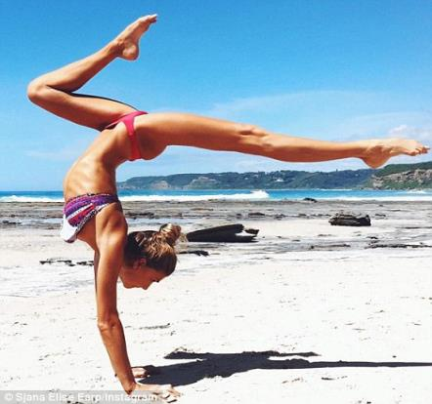
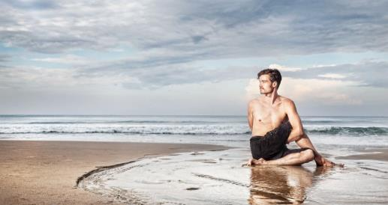
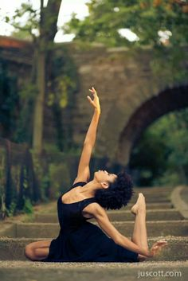
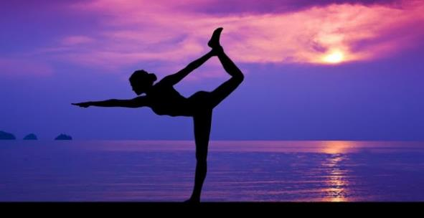
Can Every BODY really practice Yoga?

Slide 6
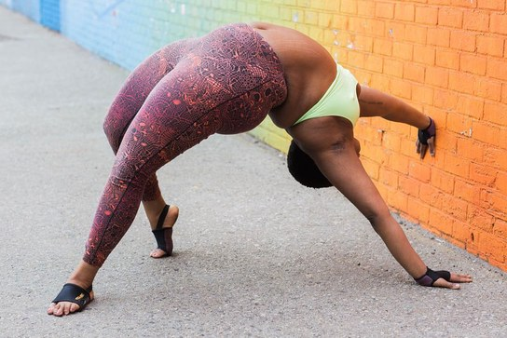
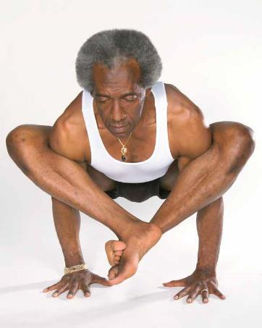
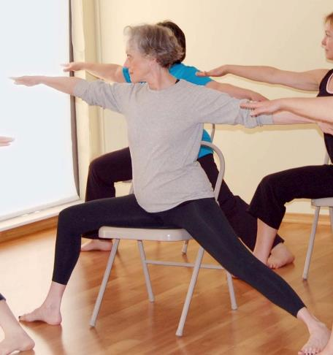
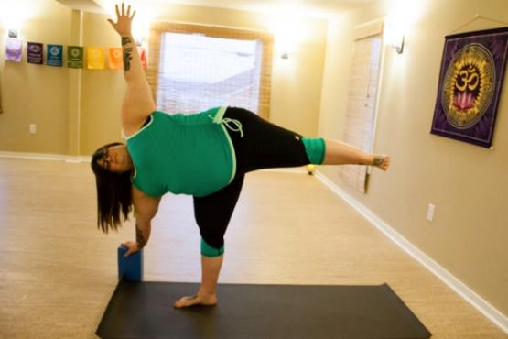
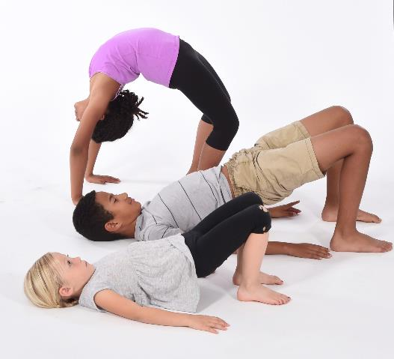
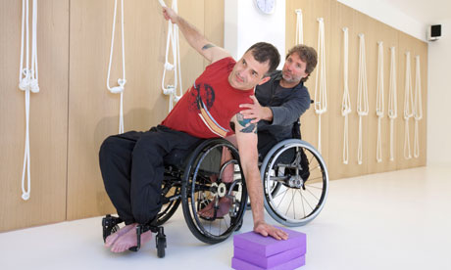
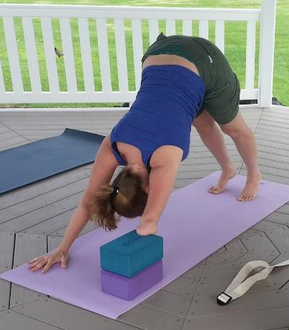
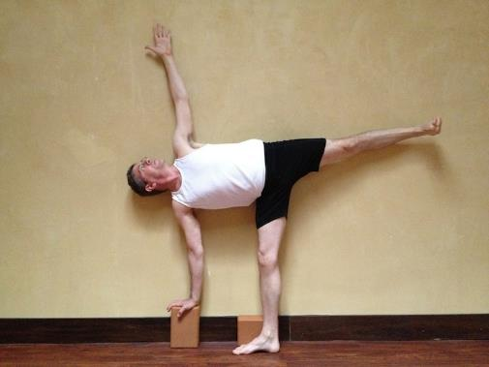
Are there bodies too: old, large, stiff, frail or restricted for yoga?

Slide 7
Yes - Every BODY can practice yoga
There is a yoga style for everyone – One size does not fit all!
Ranging from Ashtanga & Hot Flow to Chair, Svaroopa® & MIMSY
Important to practice and teach with the focus of drawing attention inward – back “home” regardless of style
Due to anatomical and other differences, not everyone can physically get “there” and look like “that”
So – adjust poses to “fit” individual bodies instead of contorting the body so it’s uncomfortable or prone to injury
Notes:
Address this issue – for those not comfortable, or who have a fear…

Slide 8
Modifications and Props are the Key
Address any bias (yours or your students’)
Individualize poses for comfort and ease
Verbal cues, props and pose modifications are all tools
Goal: Make the pose fit the person!
Will this work with ALL the poses?

Slide 9
Standing Pose: Uttanasana – Intense Forward Fold

Slide 10
Uttanasana – Intense Forward Fold Tight Hamstrings/Rounded Back

Slide 11
Uttanasana – Intense Forward Fold Extreme Stiffness, Late Pregnancy or Rehab

Slide 12
Uttanasana – Intense Forward Fold Balance Difficulties/Weakness

Slide 13
Seated Pose: Janu Shirshasana – Head-to-Knee-Pose

Slide 14
Janu Shirshasana – Head-to-Knee-Pose Hip & Hamstrings Tightness

Slide 15
Janu Shirshasana – Head-to-Knee-Pose Spinal Alignment

Slide 16
Janu Shirshasana – Head-to-Knee-Pose Larger Bellies

Slide 17
Supine/Backbend: Urdhva Dhanurasana – Upward Facing Bow Pose

Slide 18
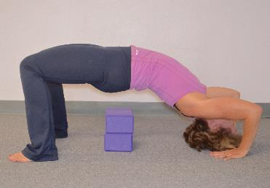
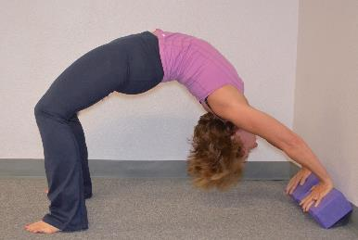
Urdhva Dhanurasana – Upward Facing Bow Pose Strength Building

Slide 19
Urdhva Dhanurasana – Upward Facing Bow Pose Confidence Building

Slide 20
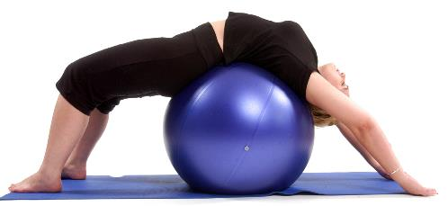
Urdhva Dhanurasana – Upward Facing Bow Pose Support for Limits in ROM

Slide 21
Urdhva Dhanurasana – Upward Facing Bow Pose Supported/Restorative

Slide 22
Inversion: Salamba Sarvangasana – Supported Shoulderstand

Slide 23
Salamba Sarvangasana – Supported Shoulderstand Aiding Hip Lift with Props
Notes:
This positioning can also be done with the legs up against a wall and using blankets as props

Slide 24
Salamba Sarvangasana – Supported Shoulderstand Upper Arm Alignment

Slide 25
Restorative/Finishing Pose: Jathara Parivartanasana – Belly Twist

Slide 26
Jathara Parivartanasana – Belly Twist Modification for Hip Replacements or Tightness

Slide 27
Jathara Parivartanasana – Belly Twist Spinal/Hip Tightness

Slide 28
Jathara Parivartanasana – Belly Twist Deepening the Pose with Physical Alignment Focus

Slide 29
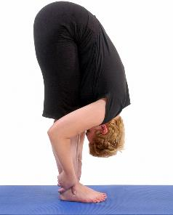
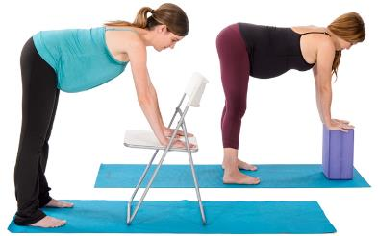
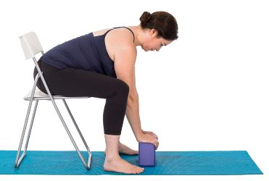
Wrap up…
All poses should provide ease, comfort & stability
Standing poses – Uttanasana
Stability, ease in hamstrings & low back
Support with blocks, chairs, a wall & widen the base
ALTER POSES TO FIT THE BODY & KEEP EASE AND COMFORT A PRIORITY!

Slide 30
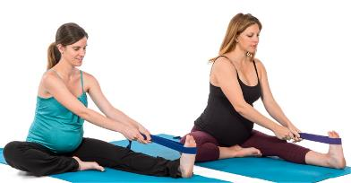
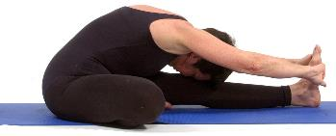
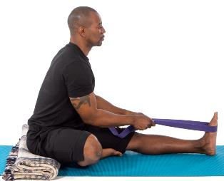
Wrap up…
All poses should provide ease, comfort & stability
Seated poses – Janu Shirshasana
Hip/spinal stability & alignment, ease & comfort in spine & legs
Prop hips with blankets, use straps
ALTER POSES TO FIT THE BODY & KEEP EASE AND COMFORT A PRIORITY!

Slide 31
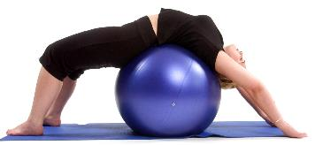
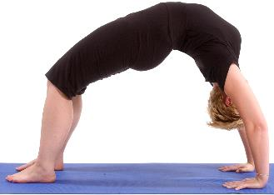
Wrap up…
All poses should provide ease, comfort & stability
Supine/Backbending poses – Urdhva Dhanurasana
Spinal support, steadiness & ease, also wrist comfort
Support with blocks, blankets, chairs & other supportive props
ALTER POSES TO FIT THE BODY & KEEP EASE AND COMFORT A PRIORITY!

Slide 32
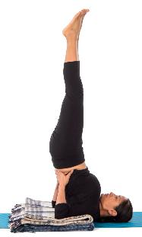
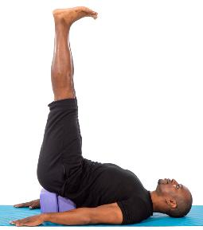
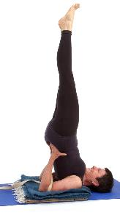
Wrap up…
All poses should provide ease, comfort & stability
Inverted poses – Salamba Sarvangasana
Balance & grounding, spinal support – core
Prop with blankets, straps, blocks and even the wall
ALTER POSES TO FIT THE BODY & KEEP EASE AND COMFORT A PRIORITY!

Slide 33
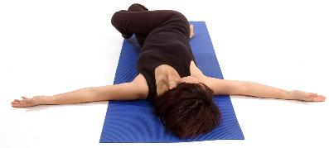
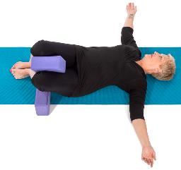
Wrap up…
All poses should provide ease, comfort & stability
Restorative/Finishing poses – Jathara Parivarttanasana
Calming and supportive, spinal support
Use blocks, blankets and the wall for propping
ALTER POSES TO FIT THE BODY & KEEP EASE AND COMFORT A PRIORITY!

Slide 34
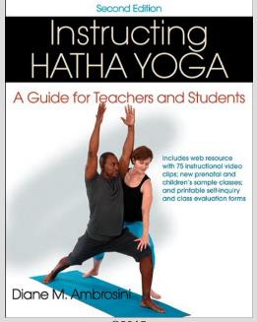
Thank you!
For more information about
Instructing Hatha Yoga 2nd ed., connect to the following link:
http://www.humankinetics.com/products/all-products/Instructing-Hatha-Yoga-2nd-Edition-With-Web-Resource
You may contact the author, Diane Ambrosini, via email at: ambroyogini1@yahoo.com

